Slide 1
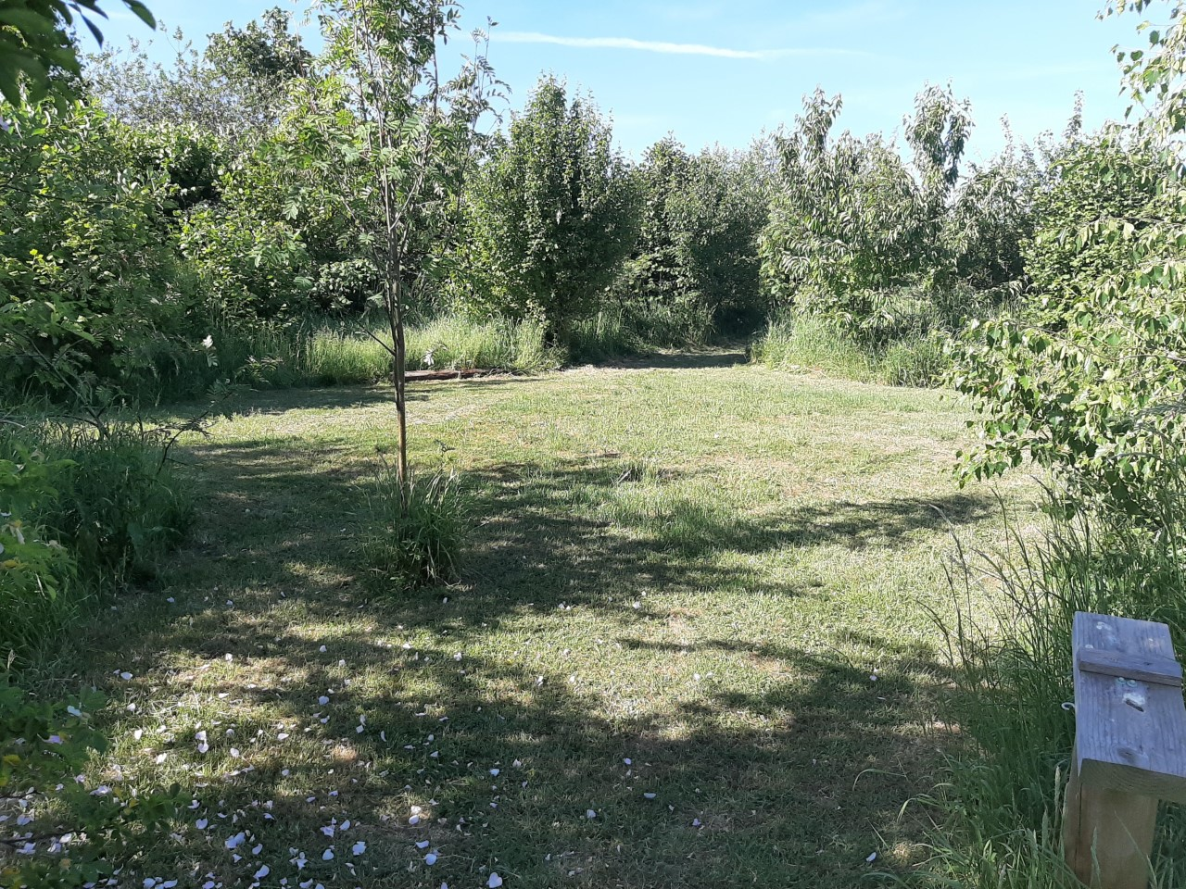
Welcome to oaktree
Information for September 2025 starters.

Slide 2
Who are we?
We are a Primary School with additional Early Years rooms which means we have children from ages 2 to 11.
We are based on a huge site in Park South. We are very lucky to have lots of beautiful areas to play and learn. We have a wildlife area, a woodland, a large field, and several outdoor playgrounds, Reception classrooms have a lovely new outdoor area with a large sandpit that the children have access to for most of the day.
We are a friendly and nurturing school (with several awards to prove it!). This means that we are not only focused on your child learning to read and write but also about their ability to make friends, be happy, make good choices and become the best version of themselves. We have a nurture room called Rainbow Room that gives extra support in these areas. We have a Hygge ethos which means we are welcoming and homely, we learn from nature and look after each child’s well-being.

Slide 3
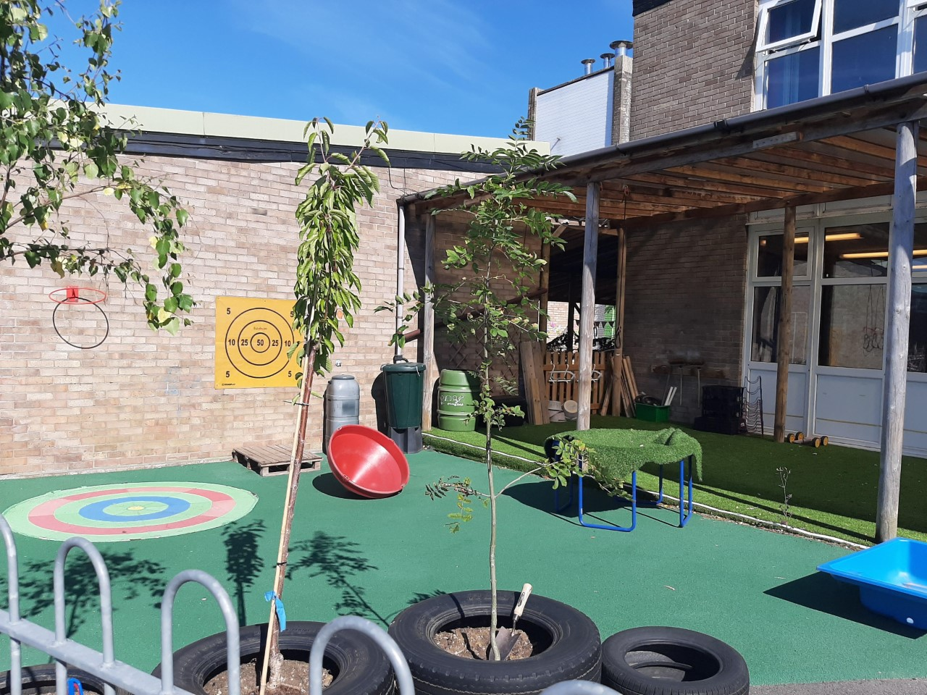
Reception classes
Your child will be in either Butterflies or Bumblebees Class.
You will hear this a lot as they quickly form a strong sense of belonging.
Miss While teaches Butterflies class with Laura.
Mrs Hooker teaches Bumblebees class with Miss Soraia.
We do lots of learning through play
We have taught sessions daily for phonics, maths and Literacy, and other sessions such as music and talking about the past.

Slide 4
What is Foundation Stage?
Foundation Stage is the part of school we also call Early Years. It includes Acorns & Nursery (Age 2 to 4) and Reception (Ages 4 and 5) . Foundation Stage ends when they go into Key Stage 1 next year.
EYFS is the framework that we follow with children from birth to 5. It sets out all the standards that we need to follow. If your child has been to nursery or a childminder they will have been following the same guidelines as us.
Early Learning Goals are the standards that a child is expected to achieve by the time they leave us next July.

Slide 5
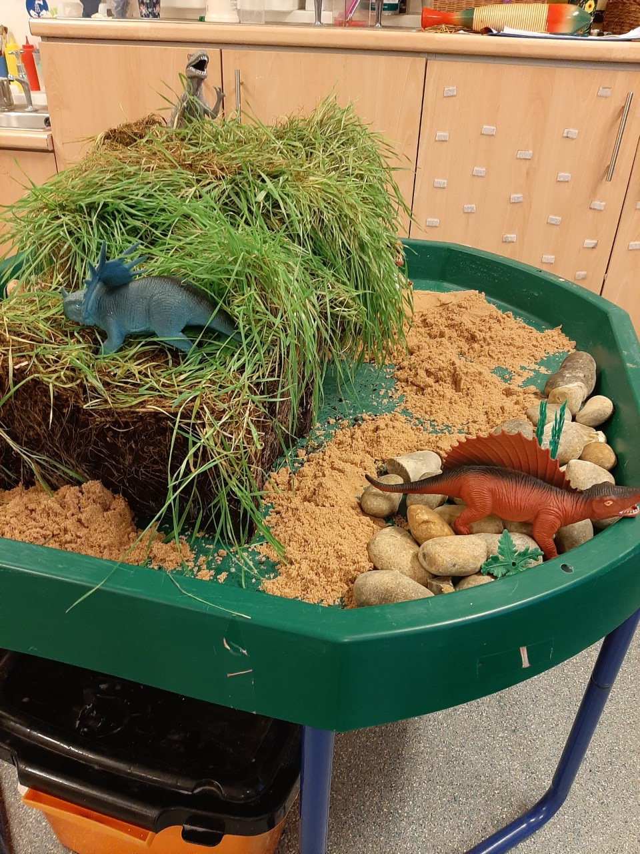
Areas of Learning and
Early Learning goals
These goals are split into 7 different areas:
Communication and Language Development
Personal, Social and Emotional Development
Physical Development
Literacy
Maths
Understanding the World
Expressive Arts and Design

Slide 6
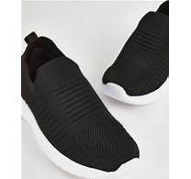

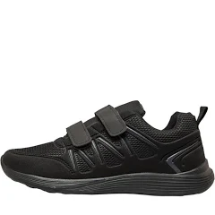

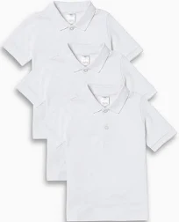
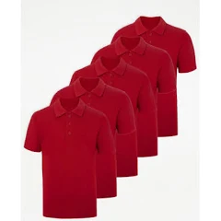
Active Uniform
Red sweatshirt – PMG School wear
Red or white polo shirt
Black jogging bottoms or leggings - PLAIN
Black trainers – NO LACES
Woodland learning – own wellies if possible, long sleeves/trousers in the summer.
PE – same as every day
Spare set of clothes to be left on their peg
You DO NOT have to have the logo on anything
Please ensure all items of clothing are CLEARLY labelled

Slide 7
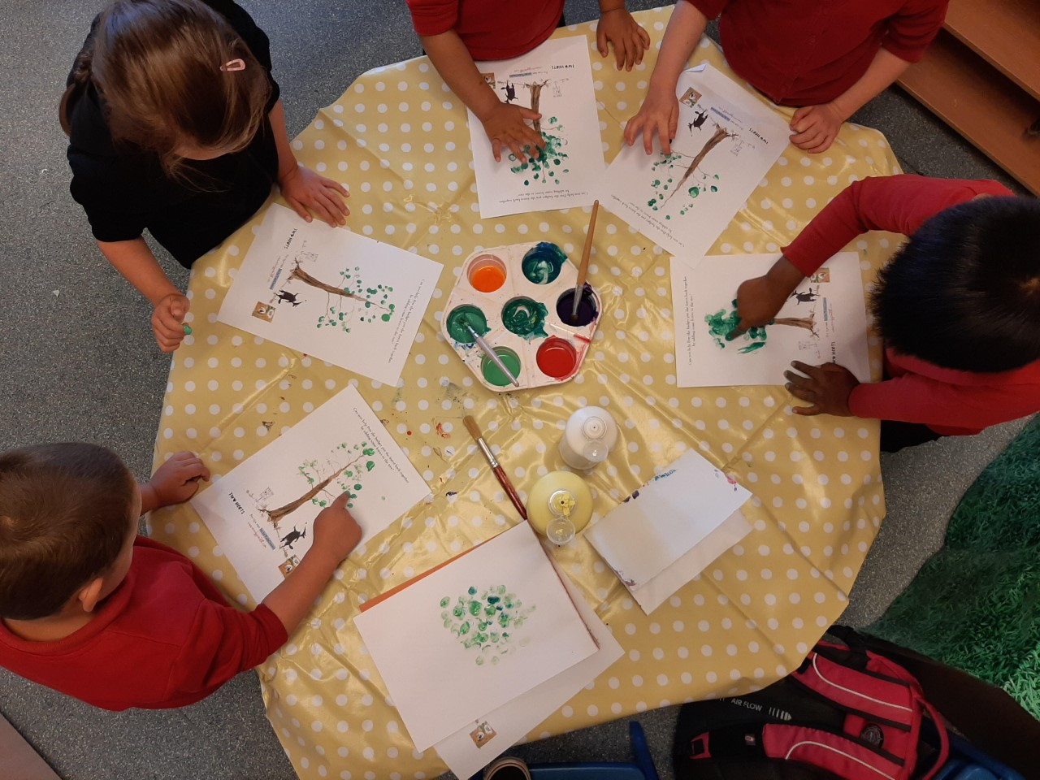
Our day
8.40 Doors open – find your name, hang up your coat, put your lunchbox in the box etc.
Register. Choose helpers - VIP for the day. Whole class wake up activity.
Phonics
Learning through play, having snack, small group work. Milk and Fruit provided free.
Maths
11.30 – 12.30 Lunch
Literacy
Learning through play
Whole class session such as Music, RE, PSHE
Story
3.10 Hometime

Slide 8
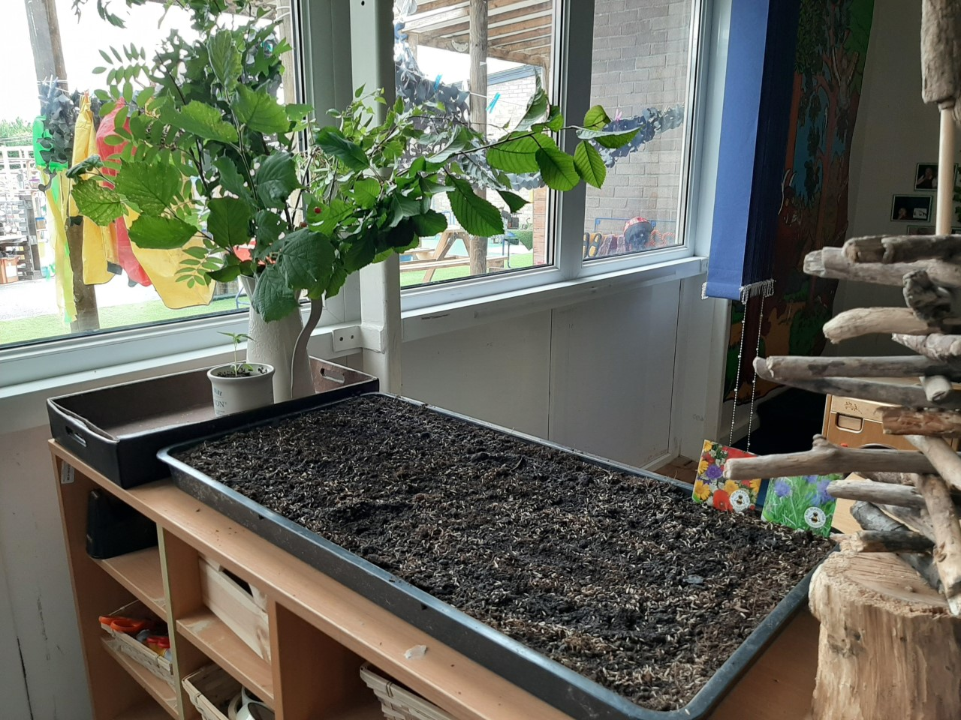
Weekly/termly extras
PE
Woodland learning
Singing assembly
Cooking
Gardening
Stay and Play
Library visits, or other local visits
We ask for £3 a term per child to cover cooking and planting costs. Snack is free.

Slide 9
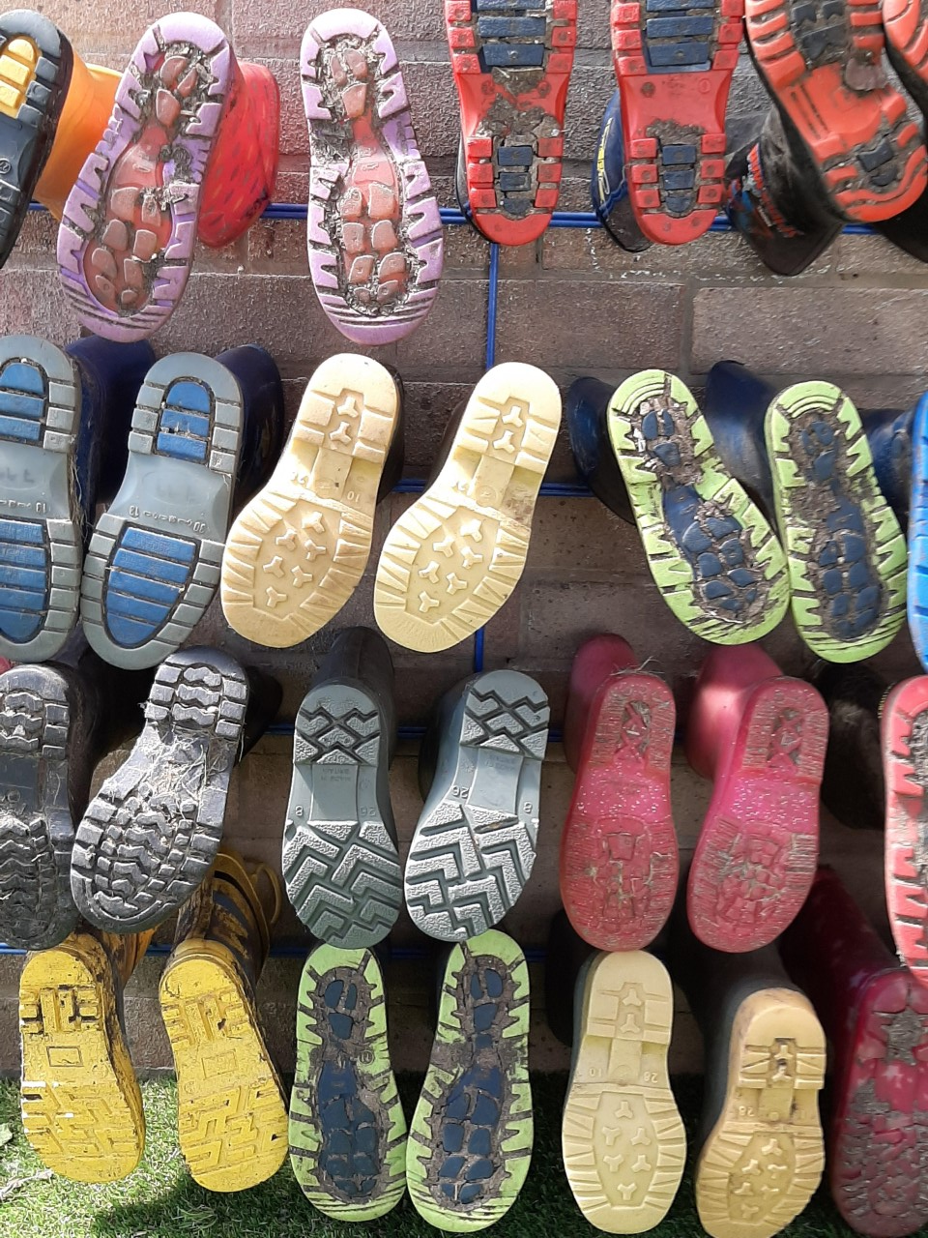
What do they need to bring to school?
Daily
Book bag – This is important to ensure that reading books are easily accessible and work your child creates can get home. Book bags are £4.50 and can be purchased via ParentPay. If your child is not yet at Oaktree, book bags will be available in September.
Packed lunch (if not having school dinners)
Named water bottle – with WATER in it
Termly
Spare clothes bag
Wellies
Please do not send your child to school with toys or money!

Slide 10
Attendance
Attendance is really, really important.
Learning is fast paced – we learn a sound once.
Socially they struggle if they miss a lot of school.
Attendance rewards – We have raffle to win a £20 Smyths Toys voucher every term. Class rewards such as pizza delivery or class disco.
Nervousness can often give children a sore tummy, headache or something that they can’t quite explain. Send them in, we will send them home if they are poorly.

Slide 11
lunches
Free hot dinners are provided – please register – even if they are having packed lunch.
You need to book dinners online. 48 school hours ahead. Registration will be provided.
There are three choices each day. Meat, vegetarian or jacket potato.
If you prefer to send a packed lunch from home you can. We ask that it is a healthy lunch with something filling such as a sandwich, wrap, pasta or rice plus a yoghurt and a piece of fruit is ideal. They can have crisps and a small chocolate biscuit/bar but not chocolate bars or sweets.
They drink water in class but can have juice or squash at lunch. No fizzy drinks.

Slide 12
Communicating with home
We use Class dojo for sharing what is happening in class. Please realise that teachers cannot always read or respond to messages during the school day and please respect that teachers need a break from school in the evenings!
We use it to send messages.
We send home paintings and creations as they do them. This gives you a chance to chat about what they did at school.
Please let us know if someone different is picking up from school.
Please let us know if your child is going to be absent from school.

Slide 13
WEbsite
You can visit our website.
You will find:
Our class pages. This will give you an idea of our classrooms, outdoor areas and the sort of activities that we do in Reception.
https://www.oaktree.swindon.sch.uk/
You can also just have a look around the website and see the sort of things we do in school.

Slide 14
What can you do to get ready?
Talk, talk, talk! Chatting to your child about what you are doing will make the biggest difference to how they get on in school.
Reading stories. Reading to them is the next best way to get them ready for school. Bedtime stories are such a lovely way to settle down for sleep.
Practical tasks. Putting on their coats and shoes is a great skill for them to learn. They feel very grown up and ready for school when they can do it (not to mention the time it saves us when going out to play!)
Toileting. Encouraging your child to go to the toilet independently is another great help.
Get into a good, healthy bedtime routine. Minimise screen time before bed. Think about how much harder everything is when you are tired.

Slide 15
September 2025
3 days of children in small groups for the morning. 3rd , 4th ,5th You will be given one of these dates for your child to attend.
3 days of half a class morning/half a class afternoon. 8th, 9th 10th Your child will attend all 3.
2 days of whole class all morning including staying for lunch. 11th, 12th
15th September – All children in full time.

Slide 16

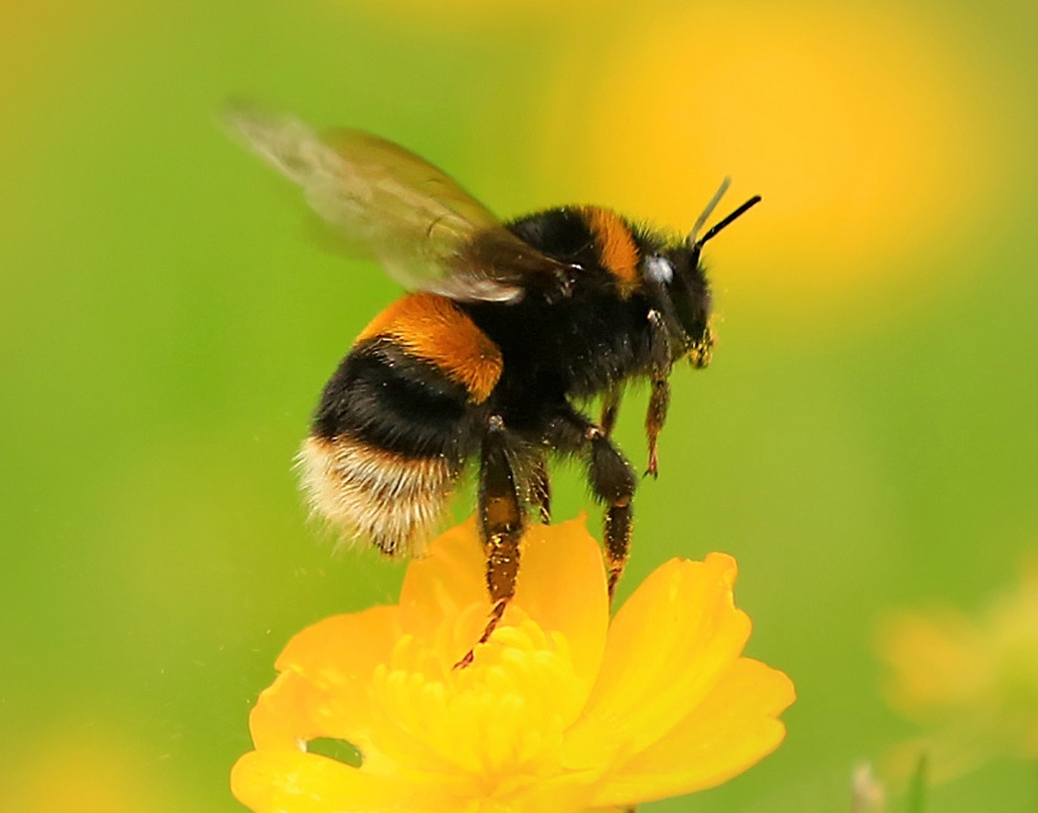
Class lists
Once the class lists are finalised, you will find out your child’s class teacher via Class Dojo (if your child is in Nursery) or phone call (If your child is new to Oaktree).
There will then be a list in Nursery to sign up to meet your child’s class teacher, and go through any remaining paperwork.

Slide 17
Forms
Free School Meal Forms – Please ensure that these are filled out. Even if your child will not be having school meals, it means you may be entitled to vouchers over the holidays. If you child has been to Nursery, you will still need to complete a new form, these have changed.
Induction Forms – These should have been sent in your induction pack, please ensure they are filled out and handed to one of the teachers.
There are spares at the front if you would like to fill them out now ☺

Slide 18
What next?
Sign up to classroom dojo.
Taster session – New to Oaktree ONLY. (Wednesday 25th 3:30pm-4:15pm)
Taster session – Oaktree Nursery children (Will be arranged with Laura)
You will have the opportunity to sign up for a meeting with your child’s class teacher to complete paperwork this will be either Tuesday 1st July or Friday 4th July.
We will sign your child up for free school meals.
Sort out uniform, book bag etc.
And don’t forget all that talking and reading!

