Slide 1
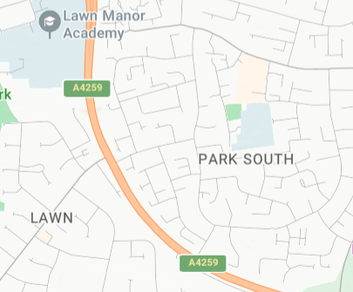
Literacy:
Poetry:
Learning, adapting and performing a poem using an extract from ‘The Centipede Song’ by Roald Dahl.
Non-Chronological Reports:
Using conjunctions, adverbs, prepositions to express time and cause.
Enquiry: Fieldwork: Map skills and 4-figure grid references, fieldwork in the local area identifying human geographical examples.
Creativity:
Art and Design: Painting:
Colour Wheel, Colour Mix, Textures.
Spanish:
A New Start: Greetings (How are you? What is your name?), Numbers and Colours
Where do we live?
We are geographers
Maths:
Addition and Subtraction:
Review strategies for adding and subtracting across 100
Place Value to 1000:
Securing place value to 100 and applying to addition and subtraction.
Bridging to 100: counting on and back in 10s, adding subtracting mulitples of 10
Measurement
Measuring length and recording in tables.
Religion and Worldwide Views:
Respectful Religion and Worldviews
What makes us Human? What is special about being a human?
Computing:
Digital Devices: What are digital devices?, What parts make up a digital device?, How do digital devices help us?
How am I connected?: How are computers connected? What does our school network look like?
PSHE:
Being Me in My World: My Year Ahead, Responsibilities, Rewards and Consequences, Our Learning Charter.
PE:
Indoor: RealPE: Coordination: Footwork; Static balance: one leg.
Outdoor: Fitness: Develop speed, strength, agility and stamina.
Music
Performance – I’ve been to Harlem
Sound Symmetry – melody and rhythms
Science:
Living Things and their Habitats:
Grouping and Classifying Animals, Habitats in the local area.

