Slide 1
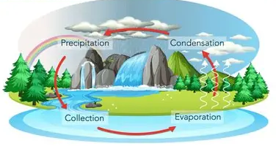
Literacy:
Setting Descriptions:
Conjunctions, expanded noun phrases, adverbs.
Explanation Texts:
Organisational features;
Language features;
Research and compilation of the text.
Enquiry: Rivers: Comparative study of the River Thames and the Amazon River, from their features to how the rivers are used.
Creativity: Art and Design:
Festival Feasts:
Sculpture, painting, drawing, collage, sketchbooks.
Spanish:
Calendar and Celebrations:
Colours, Days of the Week, Months of the Year, read and write dates learn about how Christmas is celebrated in Spain..
Where does our water come from?
We are geographers
Maths:
Place Value: 3-digit numbers
Representing 3-digit numbers, comparing and positioning on number lines
Measurement: Mass and Volume
Estimate and measure mass using grams and kilograms, understanding volume and capacity, estimate and measure using litres and millilitres, solve problems using mass and volume.
Geometry: Right Angles
Identify and describe right angles, identify properties of triangle, quadrilaterals and polygons.
Religion and Worldwide Views:
Where do our morals come from?: Learning right from wrong, what do religions believe about right and wrong, rules and religious guidance.
Computing:
Programming: Sequencing Sounds.
Scratch programming
Key Computing Skills: Logging in, saving and typing.
PSHE:
Celebrating Difference:
Families, including others, bullying, solving problems, kind words, giving and receiving compliments.
PE:
Indoor: RealPE: Real Gym
Outdoor:. GetSet4PE: Hockey
Science:
States of Matter:
Solids, liquids, gases; temperature; the water cycle; evaporation.
Music
‘March’ from the Nutcracker
Visits: River Thames (Lechlade)

