Slide 1
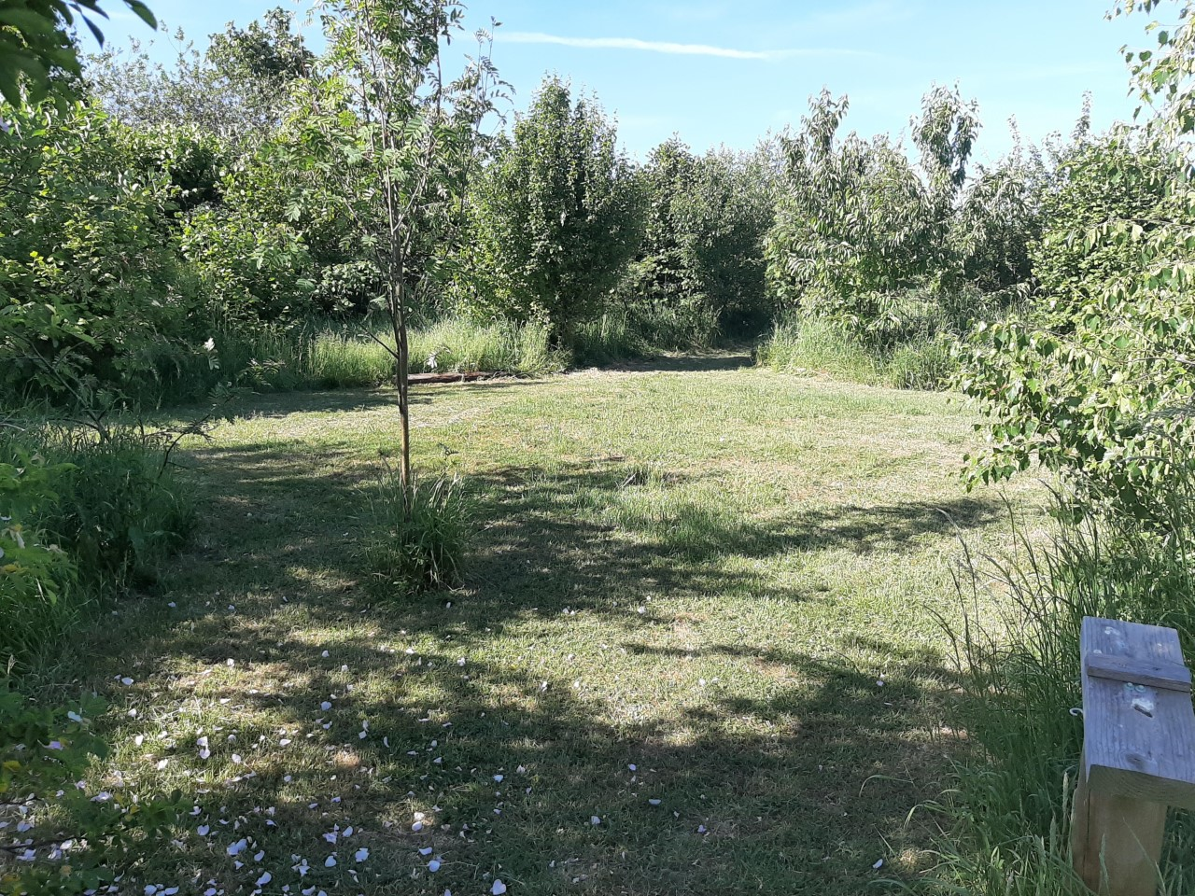
Welcome to oaktree
Information for September 2024 starters.

Slide 2
Who are we?
We are a Primary School with additional Early Years rooms which means we have children from ages 2 to 11.
We are based on a huge site in Park South. We are very lucky to have lots of beautiful areas to play and learn. We have a wildlife area, a woodland, several outdoor playgrounds, an allotment and a story telling garden. Reception classrooms have a lovely outdoor area that the children have access to for most of the day.
We are a friendly and nurturing school (with several awards to prove it!). This means that we are not only focused on your child learning to read and write but also about their ability to make friends, be happy, make good choices and generally become the best version of themselves. We have a nuture room called Rainbow Room that gives extra support in these areas. We have a Hygge ethos which means we are welcoming and homely, we learn from nature and look after each child’s well-being.

Slide 3
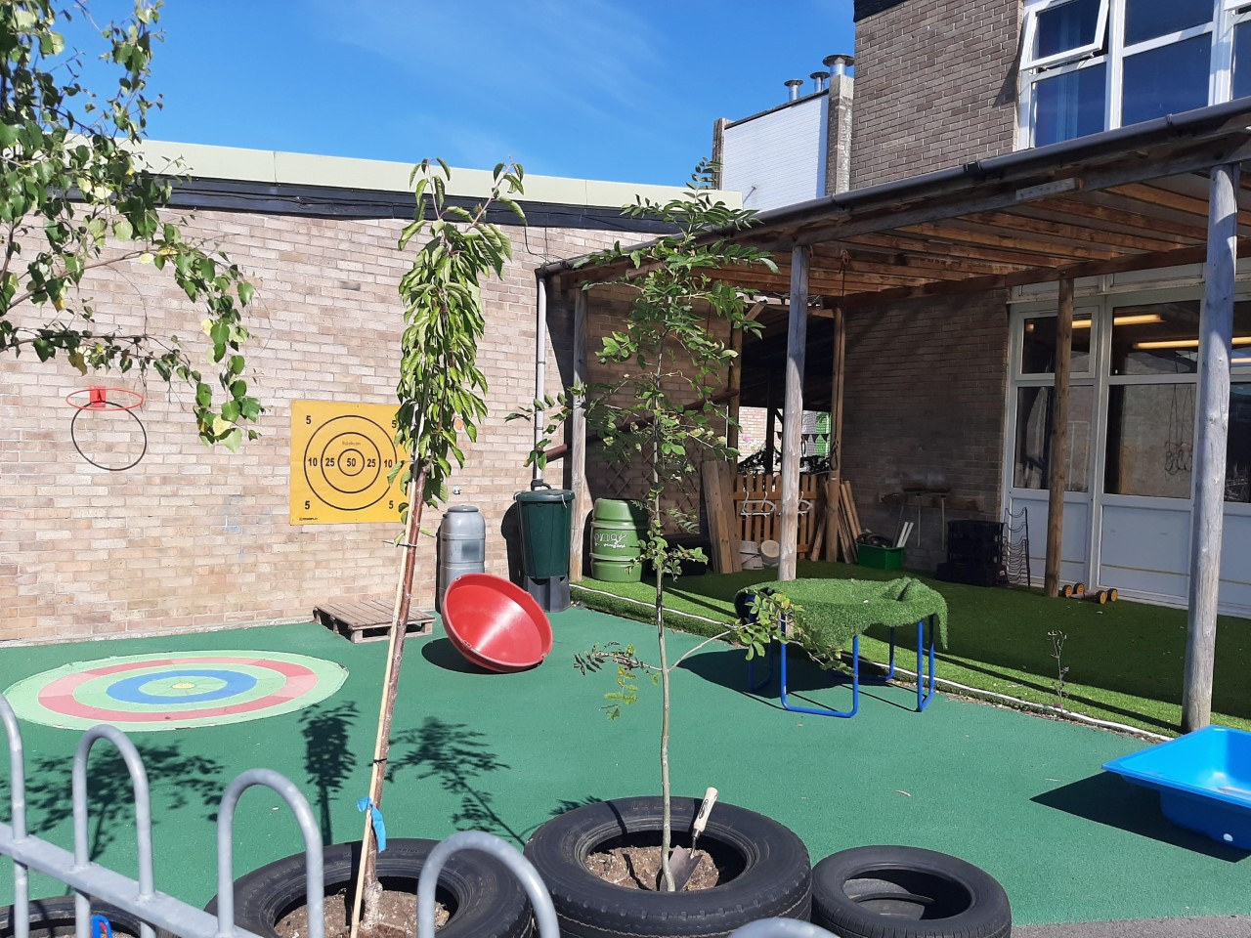
Reception classes
Your child will be in either Butterflies or Bumblebees.
You will hear this a lot as they quickly form a strong sense of belonging.
Miss While teaches Butterflies class.
Mrs Hooker teaches Bumblebees class.
Lots of learning through play
Taught sessions daily for phonics and maths and other sessions such as music and talking about the past.

Slide 4
What is Foundation Stage?
Foundation Stage is the part of school we also call Early Years. It includes Acorns (Age 2), Nursery (Age 3 and 4) and Reception (Age 4 and 5) . They leave the Foundation Stage when they go into Key Stage 1 next year.
EYFS is the framework that we follow with children from birth to 5. It sets out all the standards that we need to follow. If your child has been to nursery or a childminder they will have been following the same guidelines as us.
Early Learning Goals are the standards that a child is expected to achieve by the time they leave us next July.

Slide 5
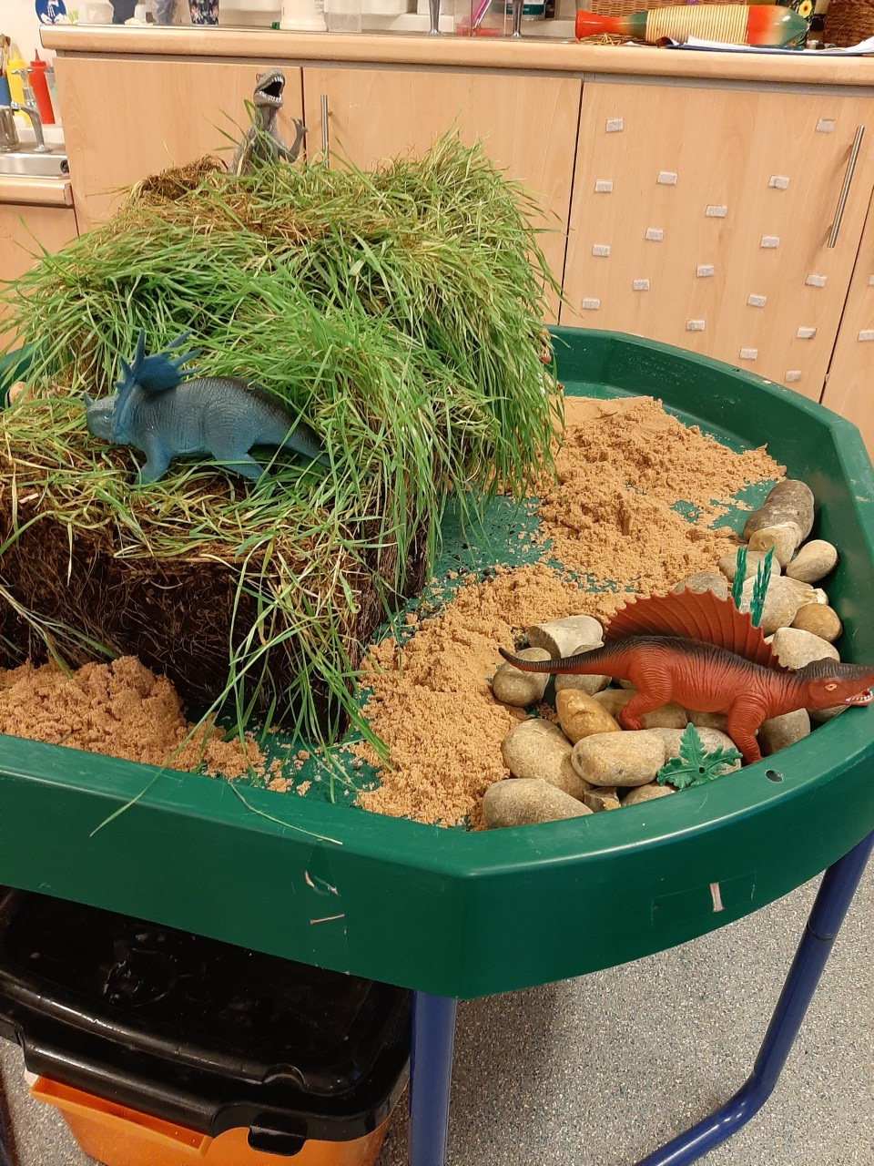
Areas of Learning and Early Learning goals
These goals are split into 7 different areas
Communication and Language Development
Personal, Social and Emotional Development
Physical Development
Literacy
Maths
Understanding the World
Expressive Arts and Design

Slide 6
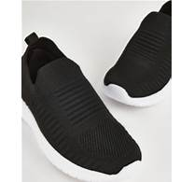
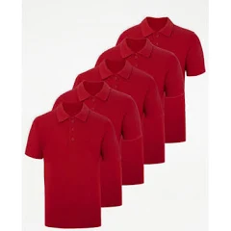
Active Uniform
Red sweatshirt PMG Schoolwear – Welcome
Red or white polo shirt
Black jogging bottoms or leggings - PLAIN
Black trainers – NO LACES
Woodland learning – own wellies if possible, long sleeves/trousers in the summer.
PE – same as every day
Spare set of clothes to be left on their peg
You DO NOT have to have the logo on anything

Slide 7
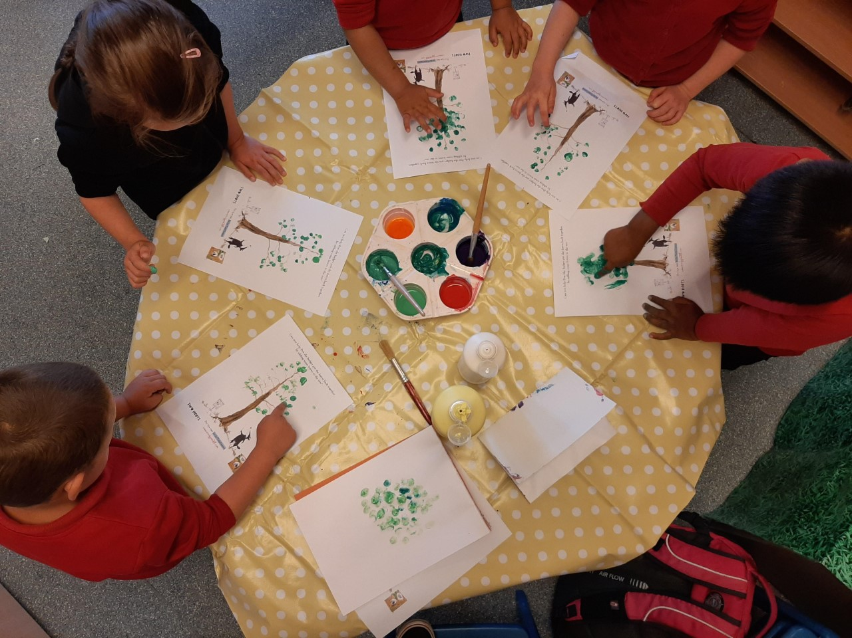
Our day
8.40 Doors open – find your name, hang up your coat, put your lunchbox in the box etc.
Register. Choose helpers - VIP for the day. Whole class wake up activity.
Phonics
Learning through play, having snack, small group work. Milk and Fruit provided free.
Maths
11.30 – 12.30 Lunch
Literacy
Learning through play
Whole class session such as Music, RE, PSHE
Story
3.10 Hometime

Slide 8
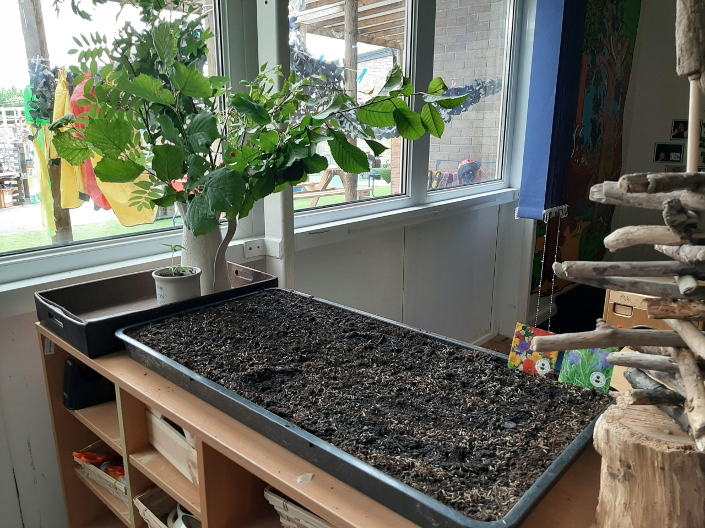
Weekly/termly extras
PE
Woodland learning
Singing assembly
Cooking
Gardening
Stay and Play
Library visits, or other local visits
We ask for £3 a term per child to cover cooking and planting costs. Snack is free.

Slide 9
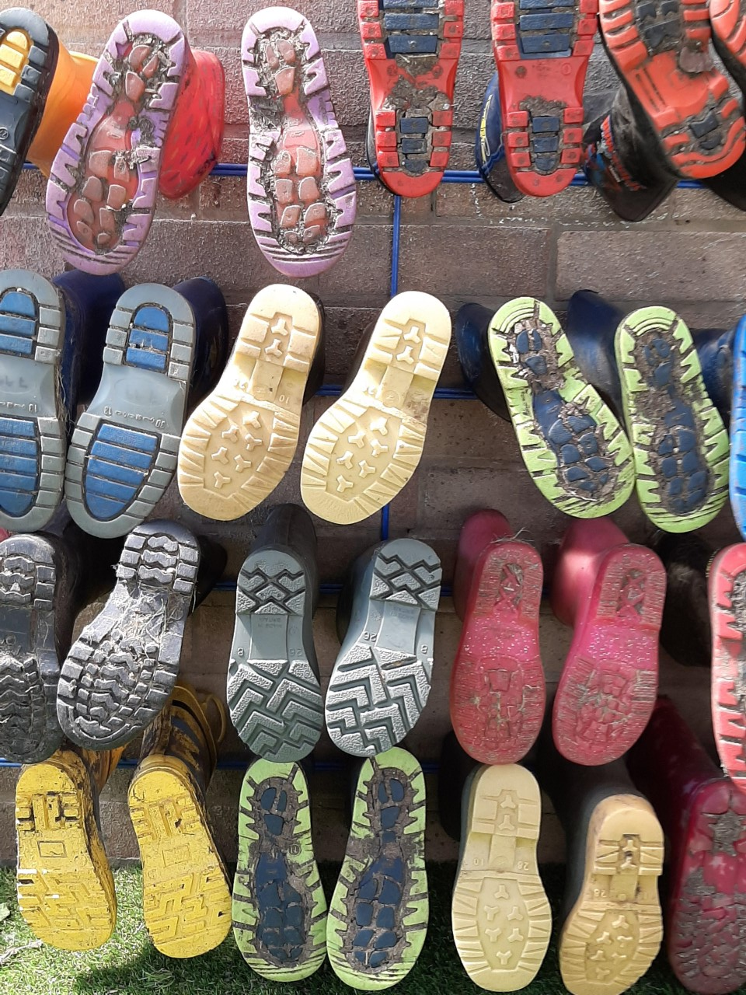
What do they need to bring to school?
Daily
Book bag
Packed lunch (if not having school dinners)
Named water bottle – with WATER in it
Termly
Spare clothes bag
Wellies
NOT toys or money!

Slide 10
Attendance
Attendance is really, really important
Learning is fast paced – we learn a sound once.
Socially they struggle if they miss a lot of school.
Attendance rewards – We have raffle to win a £20 Smyths Toys voucher every term. Class rewards such as pizza delivery or class disco.
Nervousness can often give children a sore tummy or headache or something that they can’t quite explain. Send them in, we will send them home if they are poorly.

Slide 11
lunches
Free hot dinners are provided – please register.
You need to book them online. 48 hours ahead. Registration will be provided.
There are three choices each day. Meat, vegetarian or jacket potato.
If you prefer to send a packed lunch from home you can. We ask that it is a healthy lunch with something filing such as a sandwich, wrap or roll with a yoghurt and a piece of fruit is ideal. They can have crisps and a small chocolate biscuit/bar but not chocolate bars or sweets.
They drink water in class but can have juice or squash at lunch. No fizzy drinks.

Slide 12
Communicating with home
We use Class dojo for sharing what is happening in class.
We use it to send messages.
We send home paintings and creations as they do them. This gives you a chance to chat about what they did at school.
Please let us know if someone different is picking up from school.
Please let us know if your child is going to be absent from school.

Slide 13
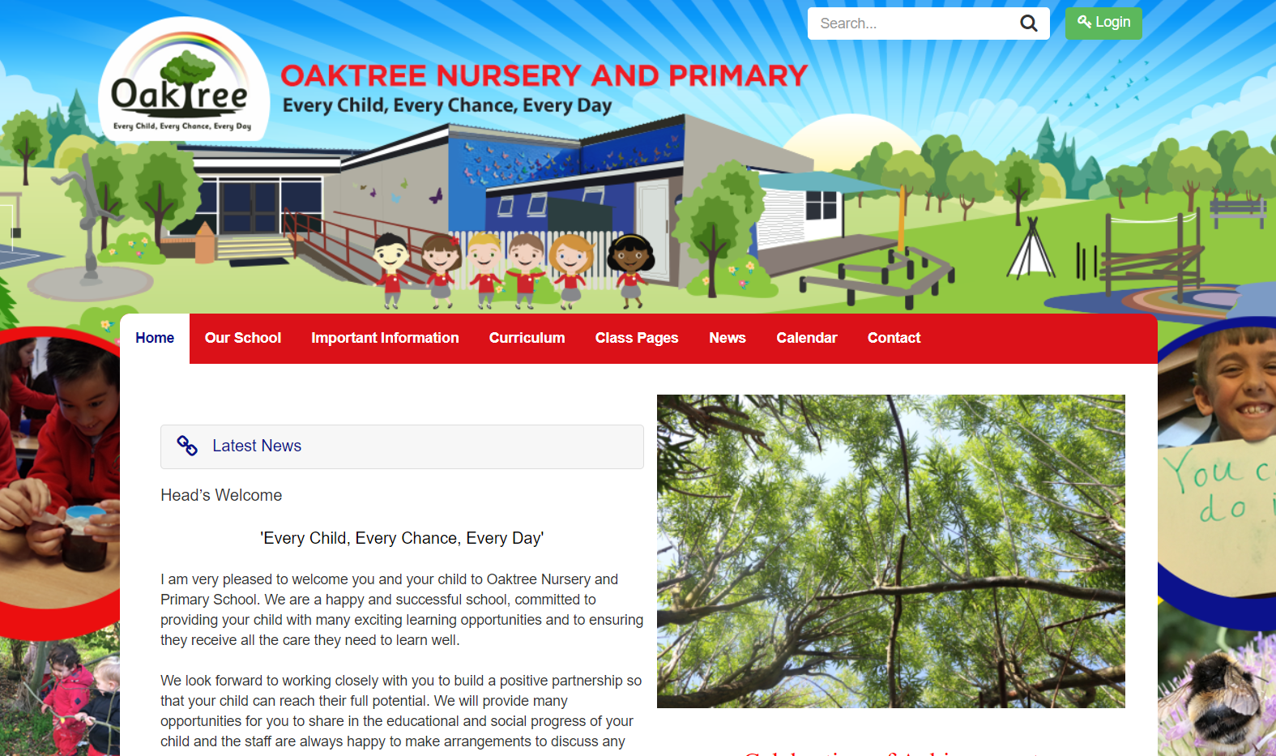
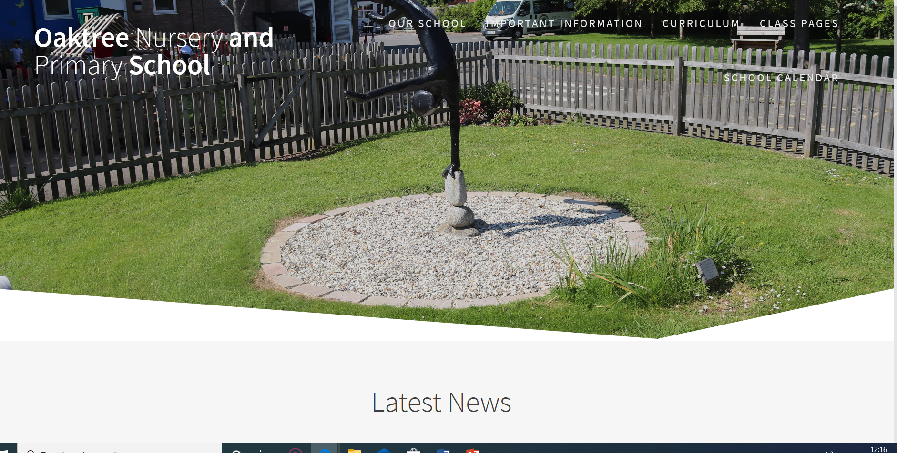
WEbsite
You can go to our website. If you google “Oaktree school Swindon” it will come up.
You will find
Our class pages
This will give you an idea of our classrooms, outdoor areas and the sort of activities that we do in Reception.
https://www.oaktree.swindon.sch.uk/
You can also just have a look around the website and see the sort of things we do in school.

Slide 14
What can you do to get ready?
Talk, talk, talk! Chatting to your child about what you are doing will make the biggest difference to how they get on in school.
Reading stories. Reading to them is the next best way to get them ready for school. Bedtime stories are such a lovely way to settle down for sleep.
Practical tasks. Putting on their coats and shoes is a great skill for them to learn. They feel very grown up and ready for school when they can do it (not to mention the time it saves us when going out to play!)
Toileting. Encouraging your child to go to the toilet independently is another great help.
Get into a good, healthy bedtime routine. Minimise screen time before bed. Think about how much harder everything is when you are tired.

Slide 15
September 2024
4 days of children in small groups for the morning. 4th, 5th ,6th and 9th You will be given one.
3 days of half a class morning/half a class afternoon. 10th, 11th 12th You do all 3.
2 days of whole class all morning including staying for lunch. 13th, 16th 17th Do all 3.
18th September – All children in full time.
If you also have a child that will be in Nursery or Acorns next year, let me know which sessions they are doing (am or pm) and we will put your child am or pm for that week.

Slide 16
What next?
Sign up to classroom dojo.
Taster sessions – New to Oaktree ONLY.
June 27th 3.30 – 4.15 and July 4th 9.30 – 11.00
Sign up for a meeting to complete paperwork and discuss your child. W/C 15th July
We will sign your child up for free school meals.
Sort out uniform, book bag etc.
And don’t forget all that talking and reading!

